Slide 1
Aquaculture biomass Part II: BY-PRODUCTS FROM FISH
R & D Center BIOINTECH
This project has received funding from the Bio-based Industries Joint Undertaking under the European Union Horizon 2020 research and innovation program under grant agreement No 790956

Slide 2
Side-stream biomass of marine origin is an important value-added resource.
By-products from fish contain some important nutrients that are good for your health.

Slide 3
Let’s see how we can use by-products
Directly for food - fresh, frozen or dried seafood products (for example cod tongue, roe, dried heads, salmon bellies and so on)
For more processed products (protein extracts, marine oils for supplements; animal feed, pet food and so on)
or discard them
Modified from Al Khawli et al. Mar. Drugs 2019, 17, 689.

Slide 4
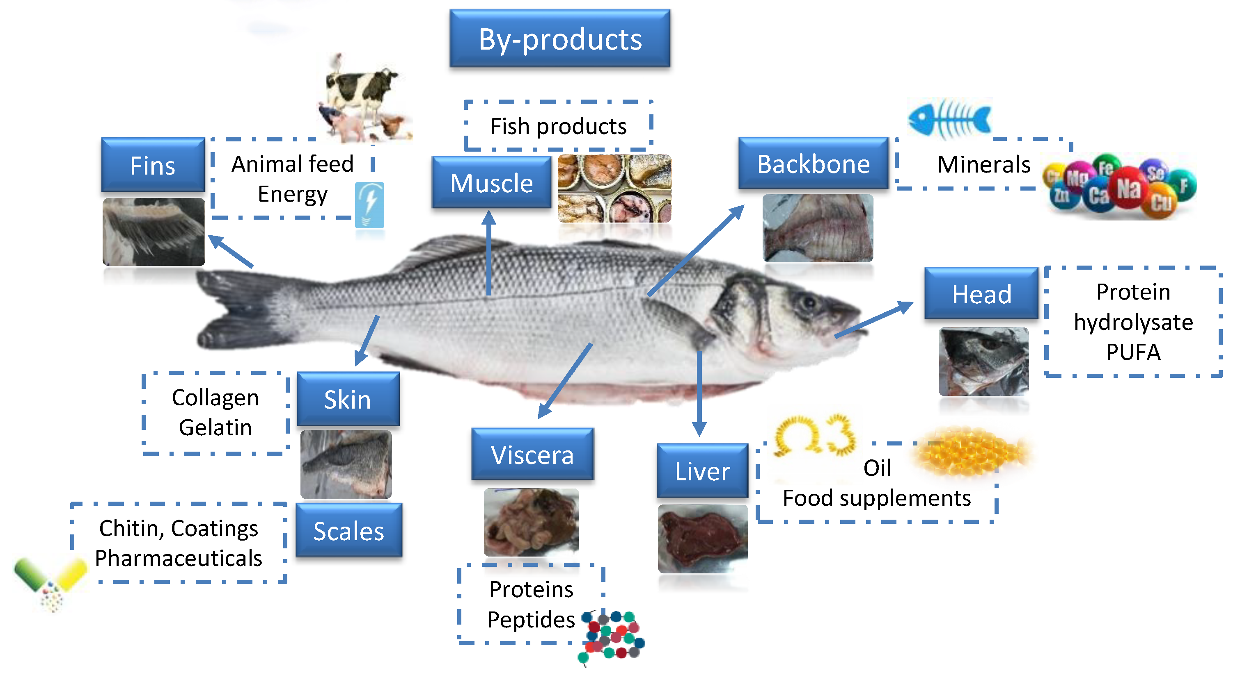
Modified from Al Khawli et al. Mar. Drugs 2019, 17, 689.

Slide 5
Muscle side-stream biomass from filleting (off-cuts) is rich in low-fat high quality protein.
It is used in many fish products:
Fish mince - comminute flesh produced by separation from skin and bones
Restructured fish products - products made from minced and/or chopped muscle with or without additional ingredients (surimi, fish fingers, analogues or substitutes that mimic seafood)
Fish burgers - a convenience food prepared out of comminute fish, spices and starch
http://www.fao.org/in-action/globefish/fishery-information/resource-detail/en/c/338772/

Slide 6
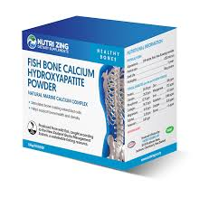
Fish bone is rich in calcium, phosphorus and other minerals.
Calcium and phosphorus form two important inorganic compounds: calcium phosphate and hydroxyapatite
Uses:
Supplements for human and veterinary use - support bone health and density
Implant material in orthopaedics and dentistry
Advantages: low toxicity and high biocompatibility
https://ebrary.net/18017/environment/fish_bones_mineral_source

Slide 7
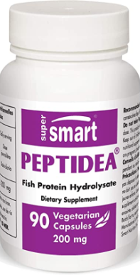
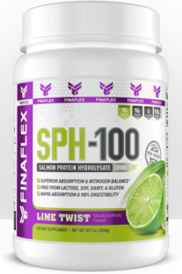
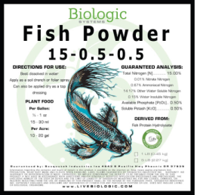
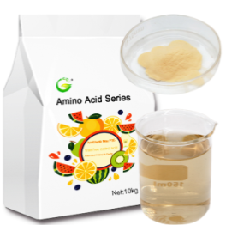
Protein hydrolysate
Protein hydrolysate – protein broken down into smaller molecules
Used as an additive in:
foods and sports supplements (support muscle recovery and muscular strength)
animal feed and pet food
cosmetics and pharmaceuticals
organic fertilizers (a source of nitrogen for plants)
Advantages: FREE from cholesterol and components that often cause allergies (soy, lactose, gluten)

Slide 8
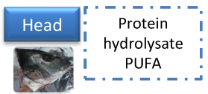
PUFA
Fish oil – PUFA stands for polyunsaturated fatty acids
Used in: aquaculture, supplements and functional foods
Western diets don’t give us all the important PUFAs that we need.
Omega-3 fatty acids (also called Omega-3 oils, ω−3 fatty acids or n−3 fatty acids) are an important group of PUFAs. Our body needs them but can’t produce them. To be healthy, we need to get them with our food.

Slide 9
What are 6 ways in which ω -3s are good for us? Watch to find out.
https://www.youtube.com/watch?v=DtZXPN-kBE8

Slide 10
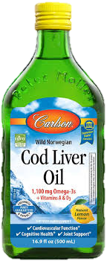
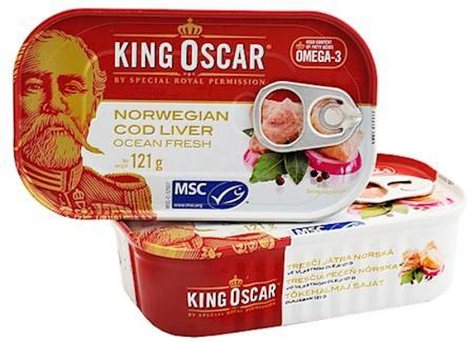
Fish liver is used as:
Delicacy or
Dietary supplement - omega-3 fatty acids plus vitamins A and D (and E)
Supports the immune system; heart, brain and joint health; overall health and wellbeing

Slide 11
We can break down side-stream fish protein into smaller compounds (peptides and amino acids). We call this processed protein:
Fish protein concentrates (FPC) - powder preparations where the protein is more concentrated than in the original fish source (used in bread, biscuits, soups and stews, macaroni, milkshakes, dietetic fruits and cereals)
Fish hydrolysates - proteins that are enzymatically broken into smaller peptides (downside: bitter taste)
Bioactive fish peptides - specific protein fragments that have a positive effect on body functions and are good for your health (for example reduce stress)

Slide 12
Processed fish proteins have many health benefits
They can act as antioxidants and antimicrobials, and can control blood pressure and modulate the immune system.
They can improve the nutritional value of food supplements for elderly people or sports nutrition.

Slide 13
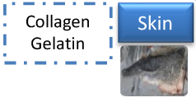
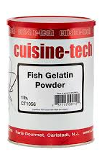
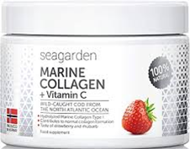
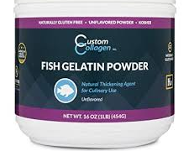
Collagen - an important component of connective tissue
Used in collagen supplements - less joint and muscle pain, better skin, stronger nails and hair
Gelatin - a mixture of peptides and proteins produced by partial hydrolysis of collagen
Used in the food industry (gummy candy, jelly; to thicken soups, stews, jams, glazes, desserts and more)

Slide 14
Chitin - a polysaccharide
Used in:
pharmaceuticals and cosmetics
food and feed additives, agriculture
semi-permeable membranes
textile industry
waste water treatment
packaging (biodegradable filler)

Slide 15
Used in:
Ingredients in animal feed (especially for poultry, swine, mink, farm-raised fish, and pets)
Bioenergy production – biogas, biodiesel (together with scales and fish viscera)

Slide 16
Some big commercial ships process the fish on board so they do not bring the side-stream biomass to land
It must be economically possible to process this remaining biomass

Slide 17
The good news is that...
The pelagic sector utilizes almost 100% of the residual raw materials.
The aquaculture sector uses everything except the blood. Researchers are looking for ways to utilize the blood, too.

Slide 18
The end!

Slide 19
Thank You
www.aquabioprofit.eu
twitter.com/aquabioprofit
facebook.com/aquabioprofit
linkedin.com/company/aquabioprofit

